Slide 1
Solar Energy Forecasting Using Weather data and Machine Learning methods
Bradley Payne

Slide 2
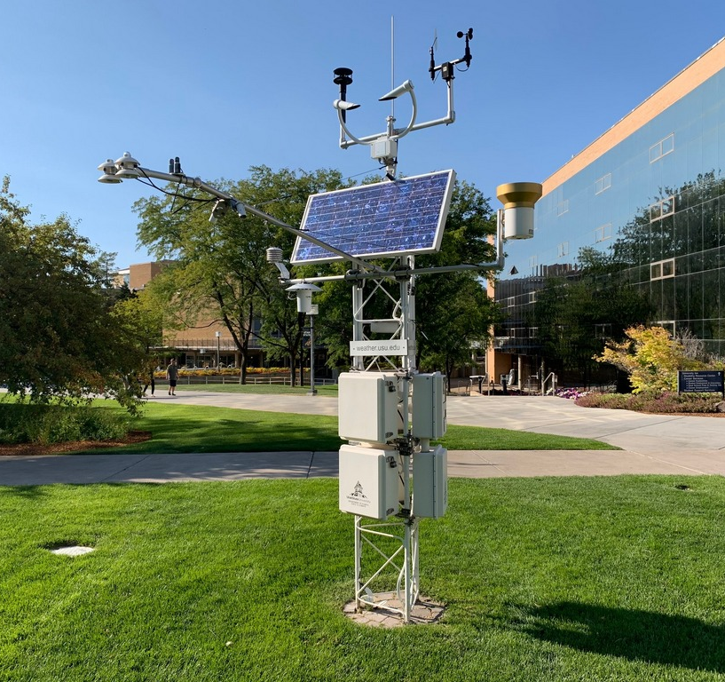
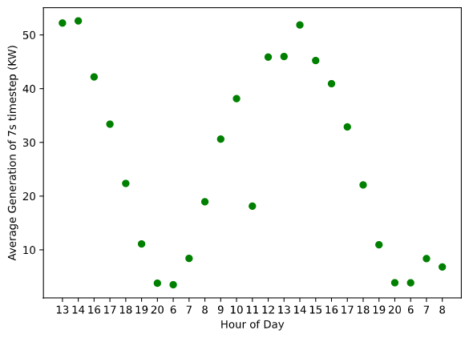
The Data
Weather Data from USU Climate center
Solar Generation from Aspire labs
USU Environmental Observatory

Slide 3
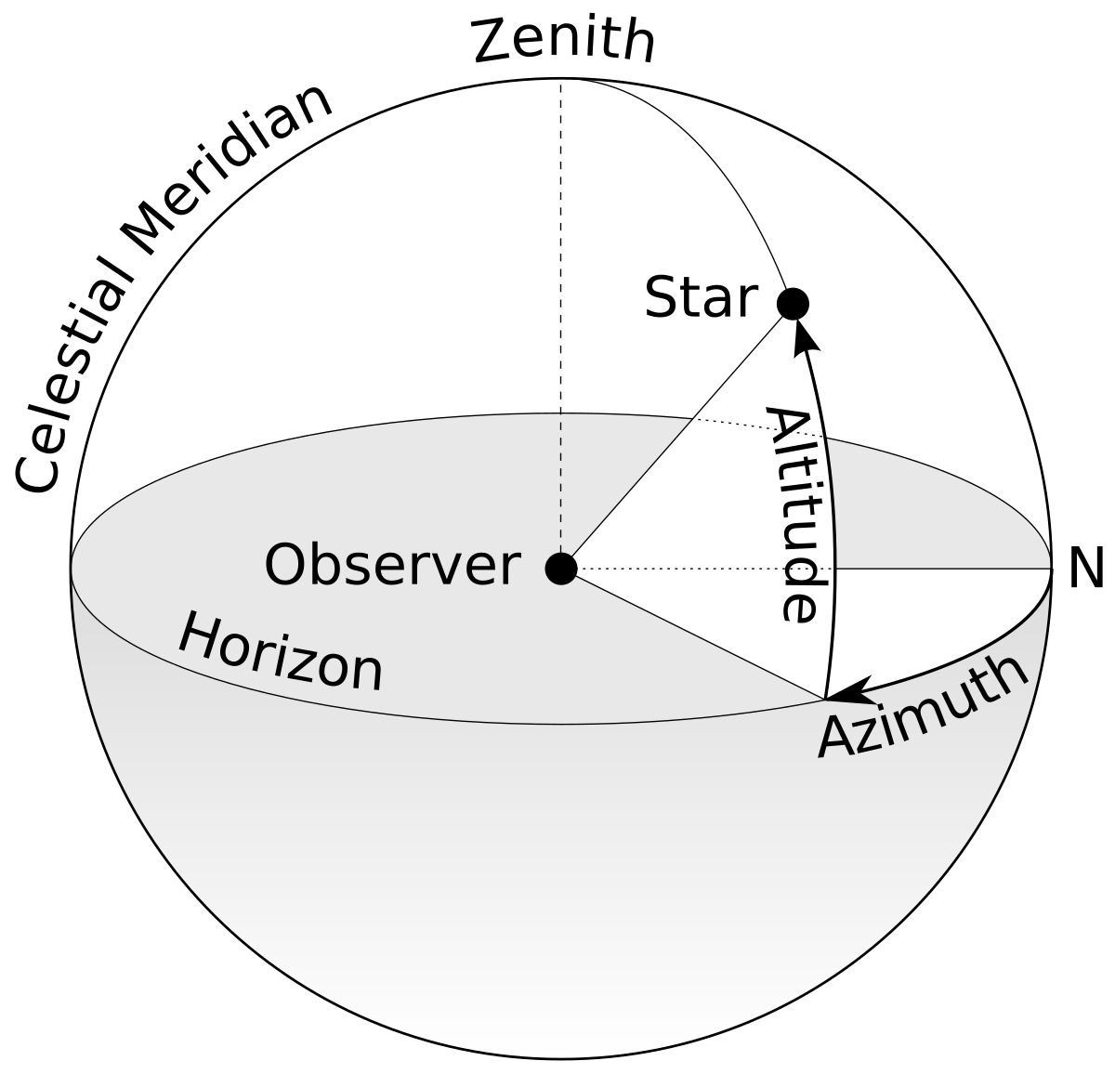
Data Curation
31% of the Solar Data was garbage collection or otherwise corrupted
Affected 44% of the hours
Experimented with using the aggregate sum of hour as well as the average produced by each timestep in a certain hour
Supplemented weather data with Azimuth, Zenith, and Elevation angle for each hour (using Astral package)

Slide 4
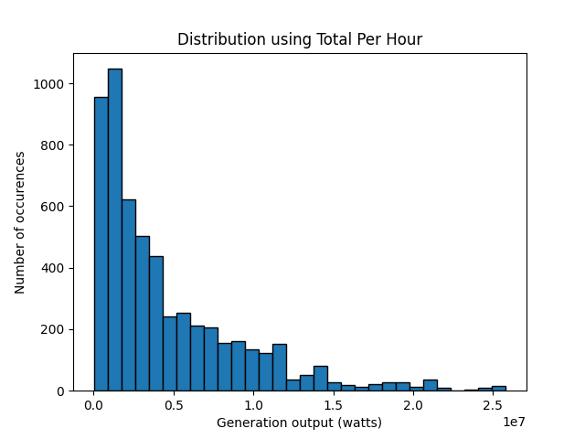
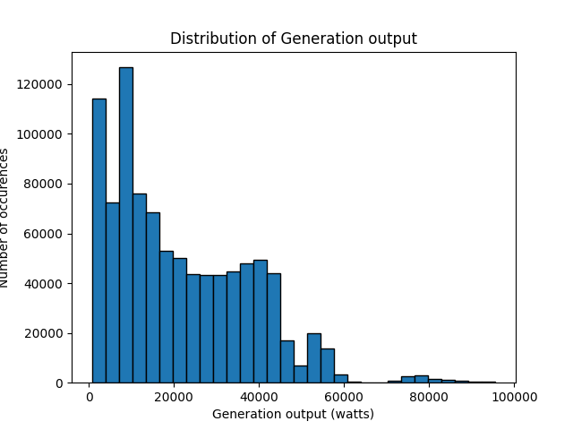
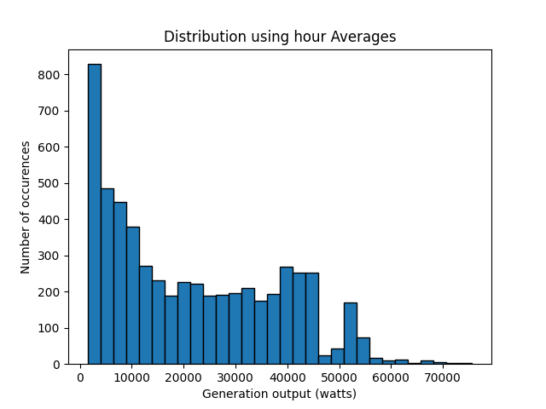
Solar Data

Slide 5
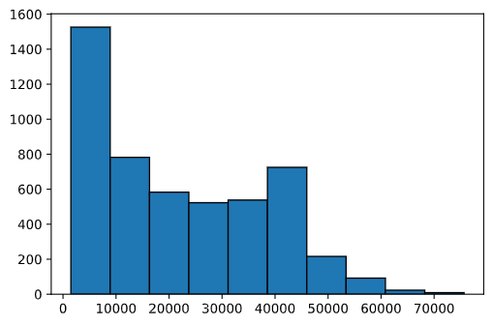
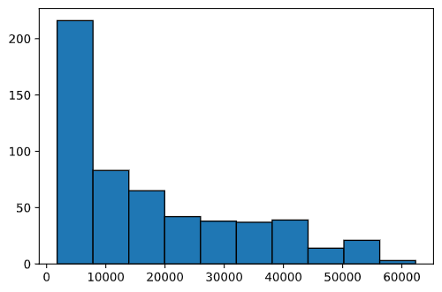
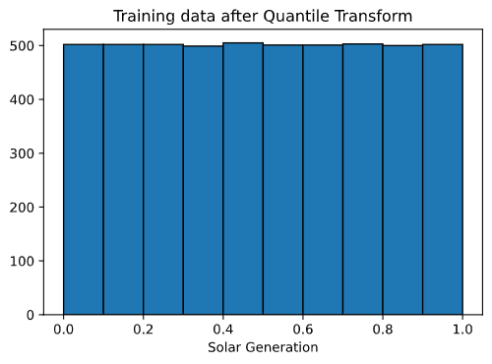
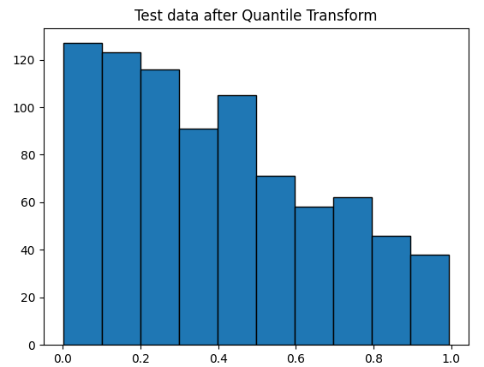
Split and transform
85 – 15 training, testing split
Transformed using QuantileTransformer in sklearn
Transformation helped models

Slide 6
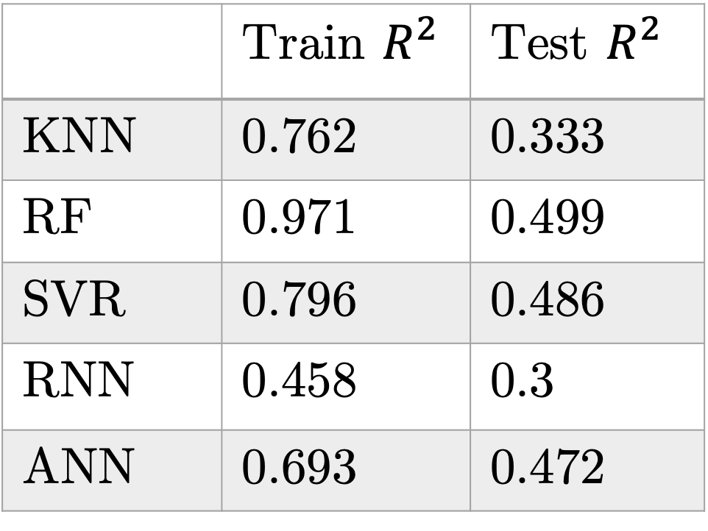
Results (on total solar)
 | Train $R^{2 }$ | Test $R^{2}$
KNN | 0.762 | 0.333
RF | 0.971 | 0.499
SVR | 0.796 | 0.486
RNN | 0.458 | 0.3
ANN | 0.693 | 0.472
K-Nearest Neighbors(KNN)
Random Forest (RF)
Support Vector Regression (SVR
Recurrent Neural Network (RNN)
{L10, L10, 10, 1}, Adam, lr 0.001, batch size 128, epochs 100, dropout 0.2
Artificial Neural Network (ANN)
{20, 10, 1} Adam, lr 0.001, batch size 50, epochs 100, dropout 0.2

Slide 7
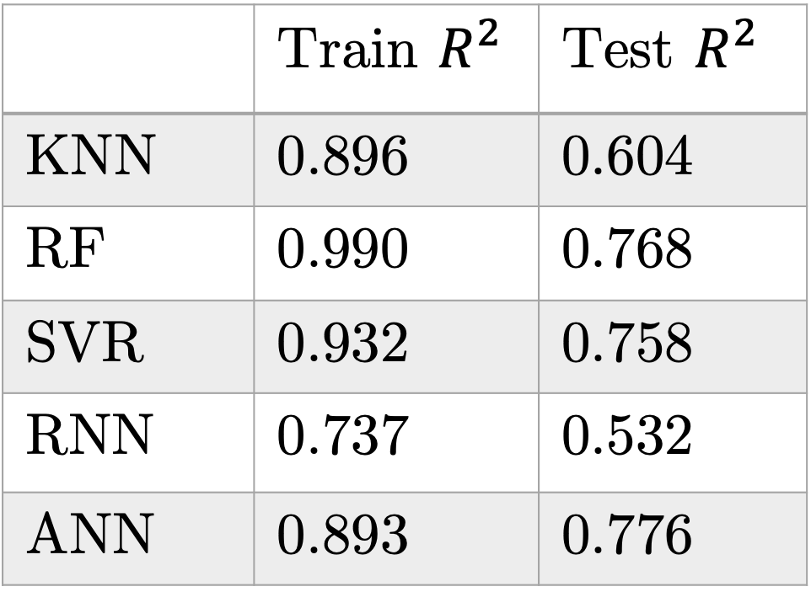
Results (on average solar)
 | Train $R^{2 }$ | Test $R^{2}$
KNN | 0.896 | 0.604
RF | 0.990 | 0.768
SVR | 0.932 | 0.758
RNN | 0.737 | 0.532
ANN | 0.893 | 0.776
K-Nearest Neighbors(KNN)
Random Forest (RF)
Support Vector Regression (SVR
Recurrent Neural Network (RNN)
{L10, L10, 10, 1}, Adam, lr 0.001, batch size 128, epochs 250, dropout 0.2
Artificial Neural Network (ANN)
{20, 10, 1} Adam, lr 0.001, batch size 50, epochs 100, dropout 0.2

Slide 8
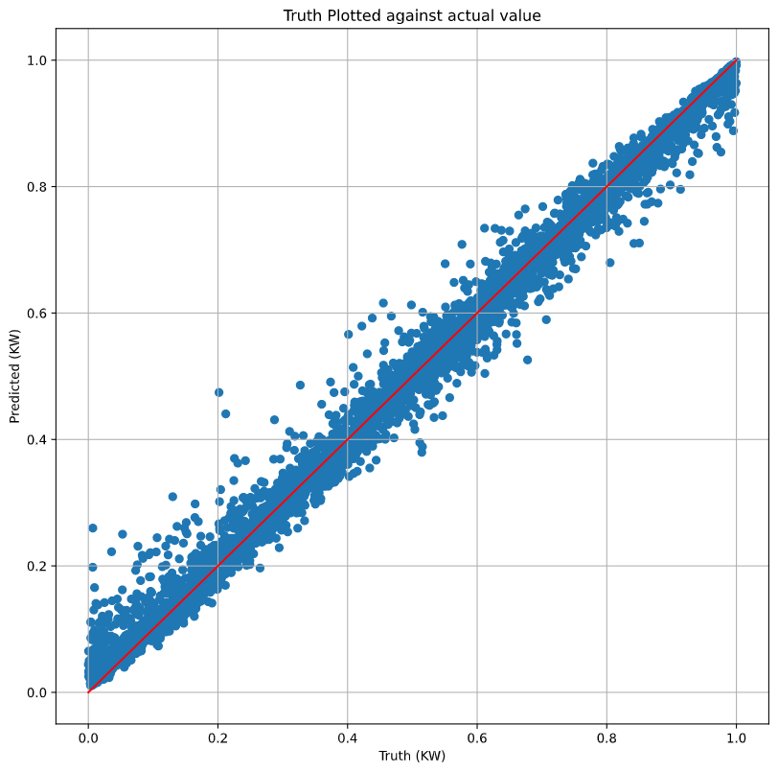
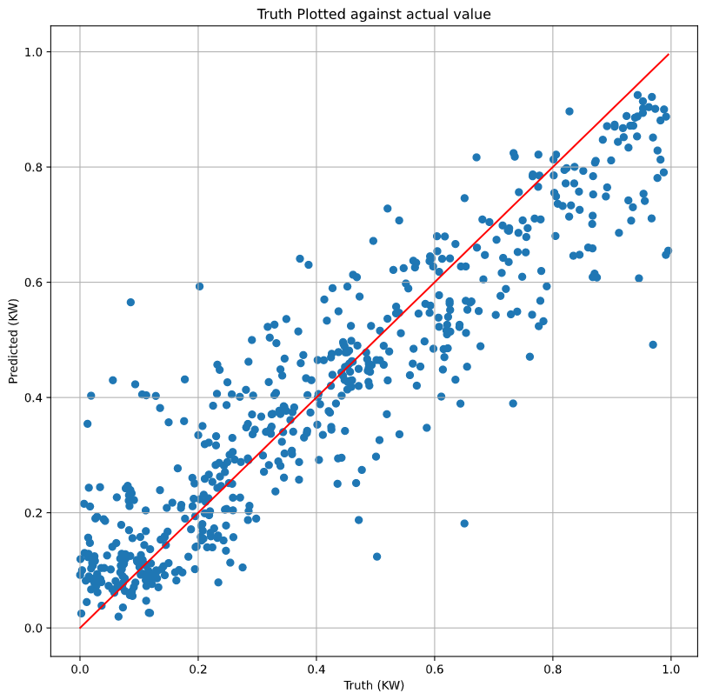
Results continued (RF)

Slide 9
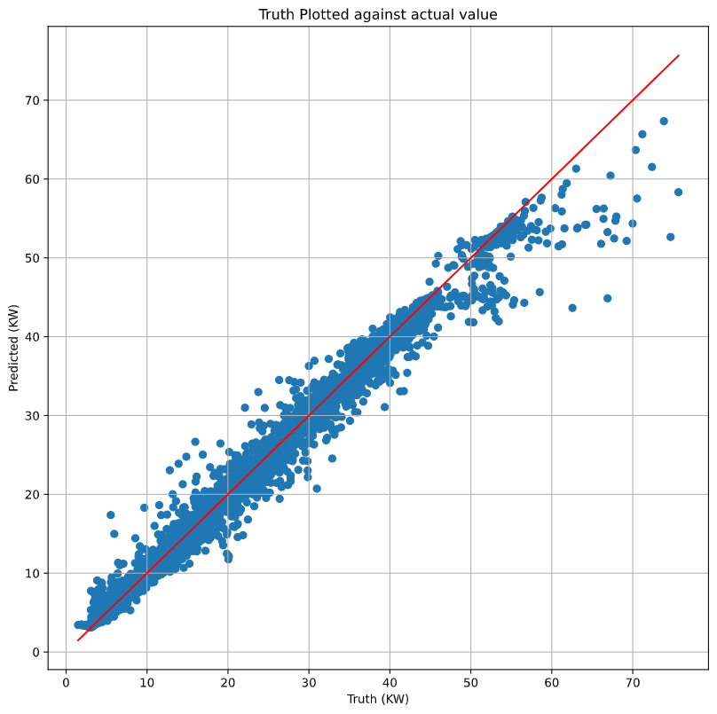
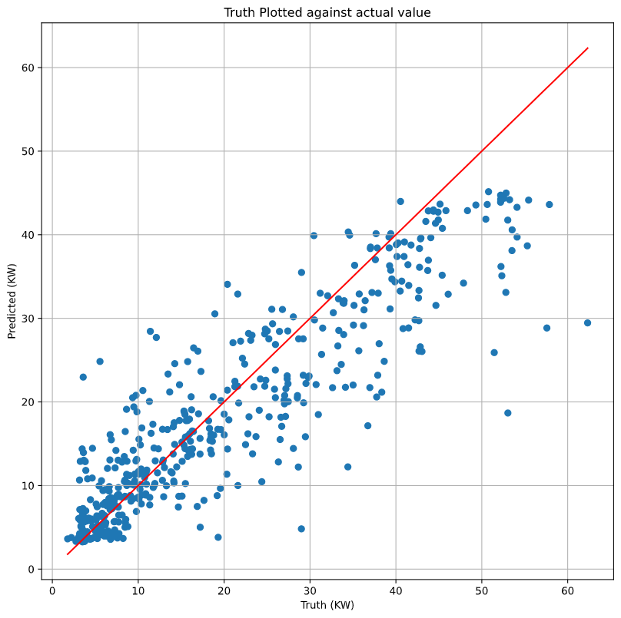


Results continued (RF)
$$R^{2}:0.990$$
$$R^{2}:0.768$$

Slide 10
Next Tasks
Based on Research Papers’ methods:
Split data into seasons and fit random forest
Previous average for hour of day
PCA (if time)
For the Class:
Poster
Paper

Slide 11
Resources
“Solar Power Forecasting with Machine Learning Techniques”
“Deep Learning for Big Data Time Series Forecasting Applied to Solar Power”
“Forecasting of Solar Energy with Application for a Growing Economy Like India: Survey and Implication”

